Slide 1



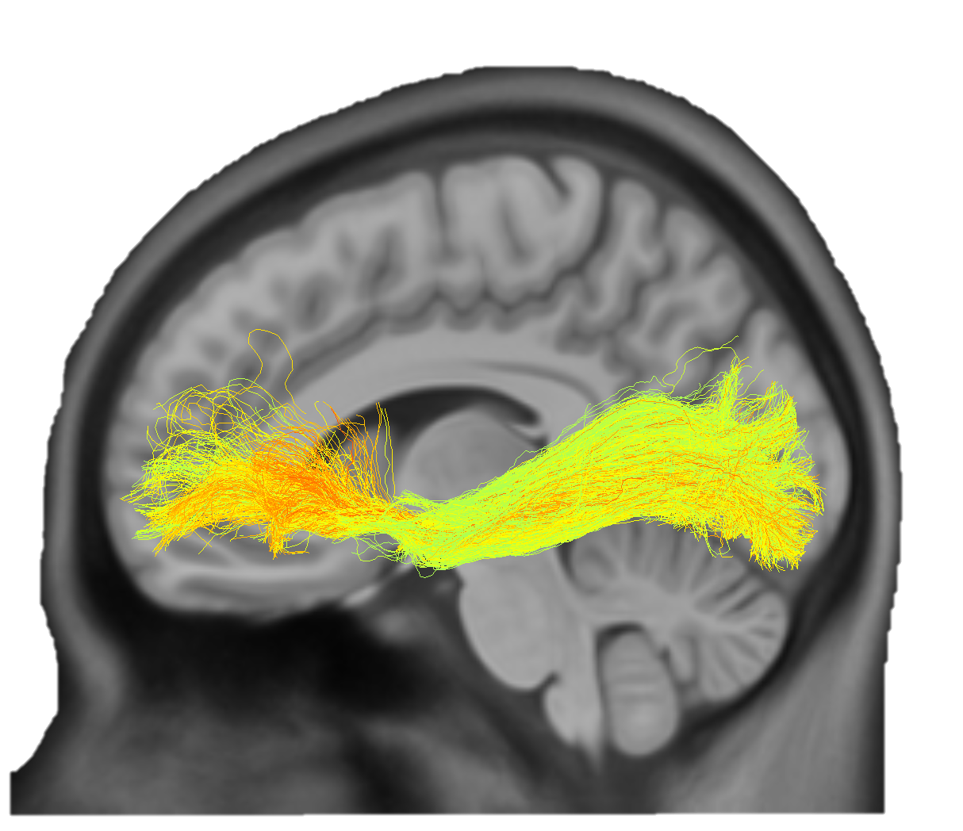
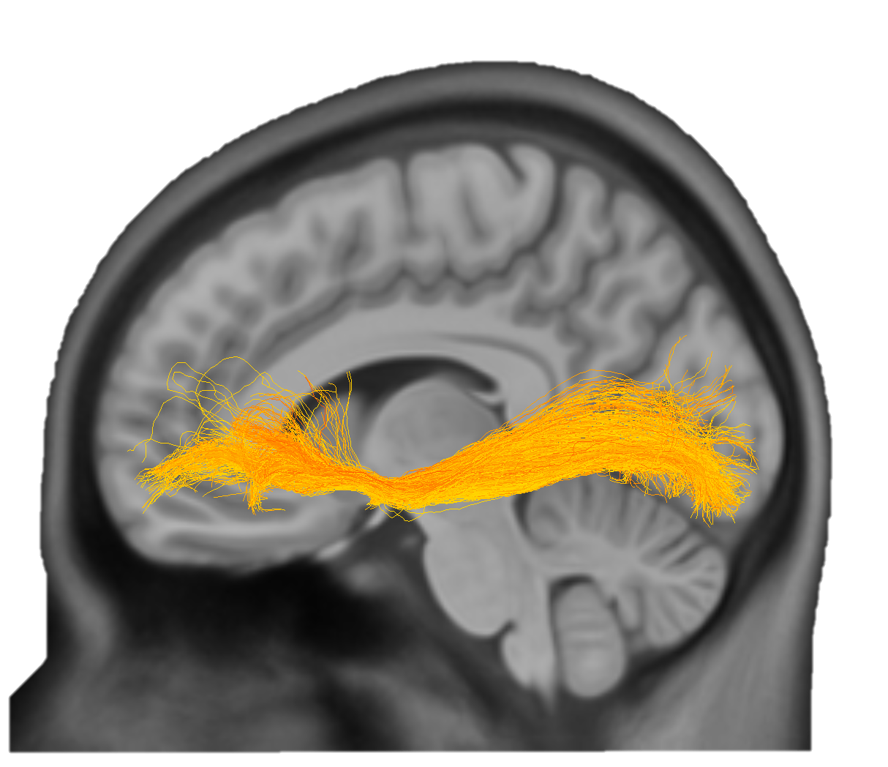
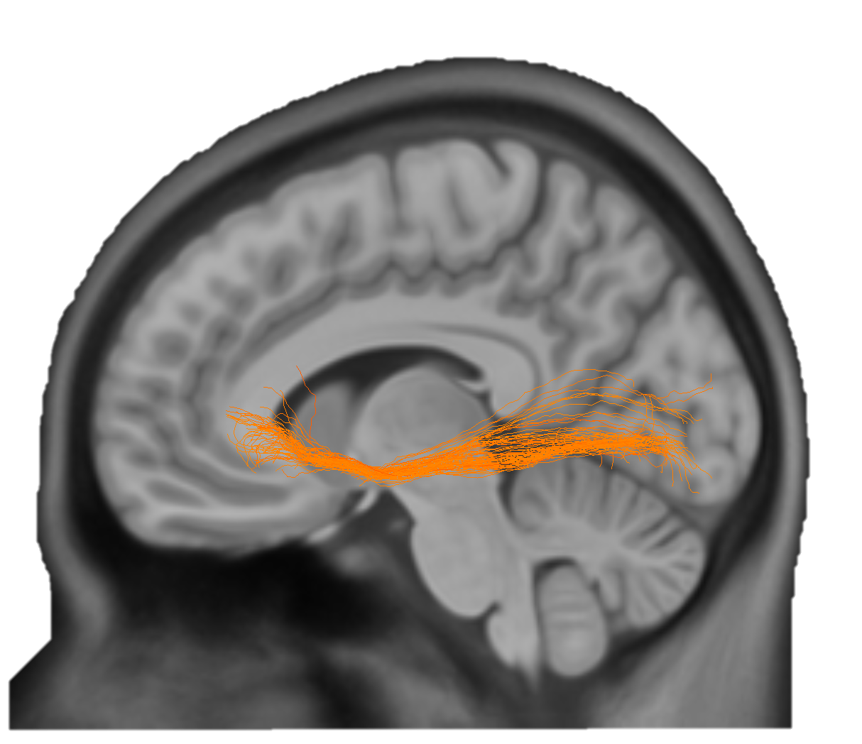
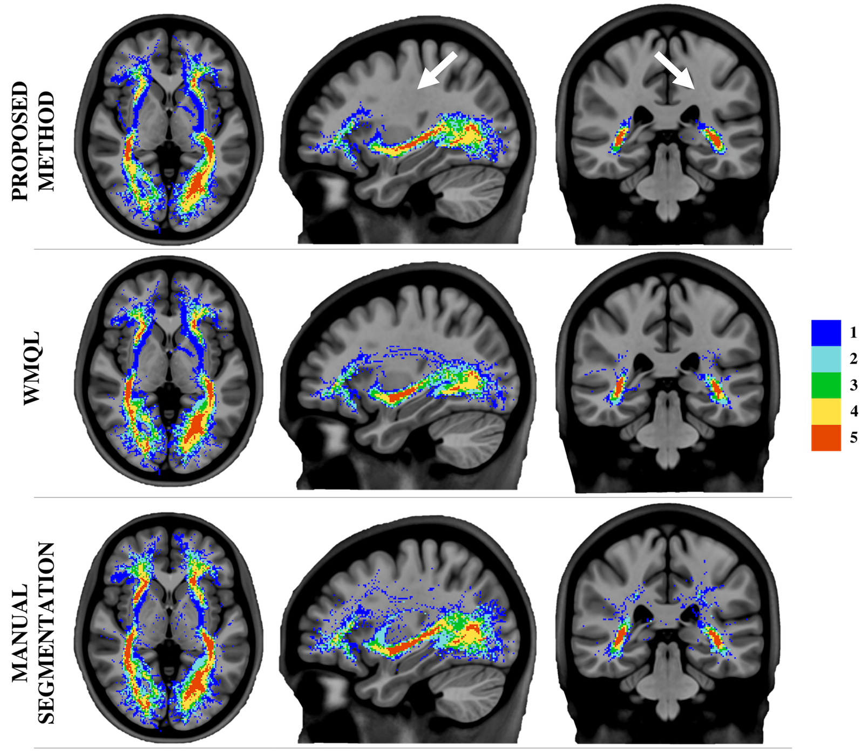
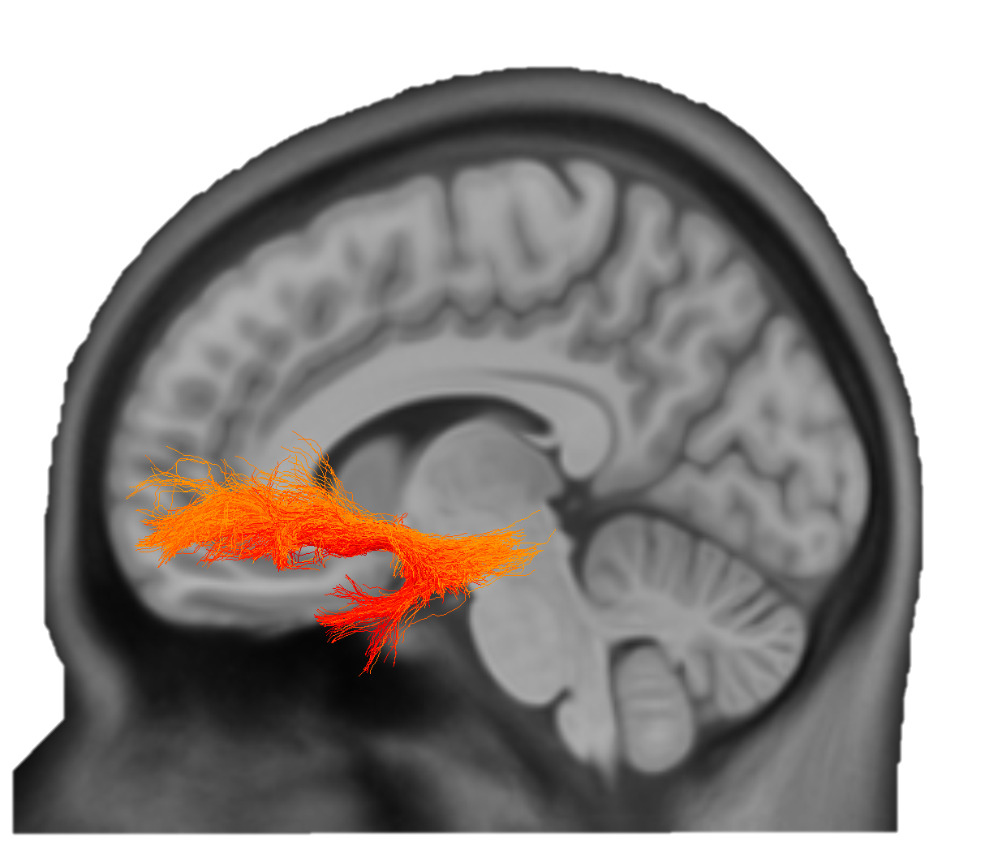
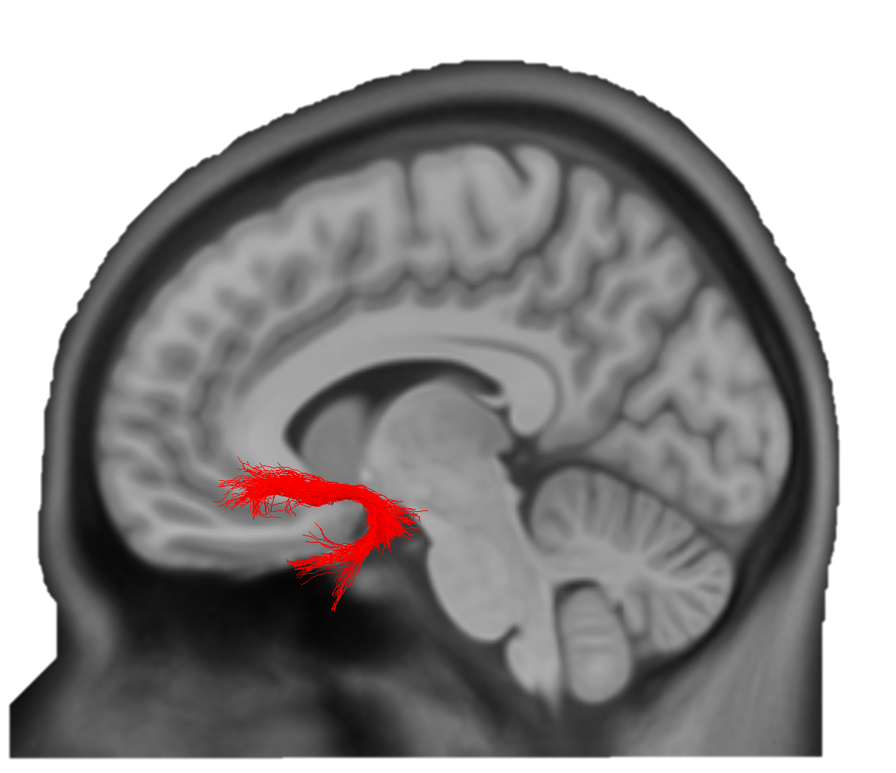

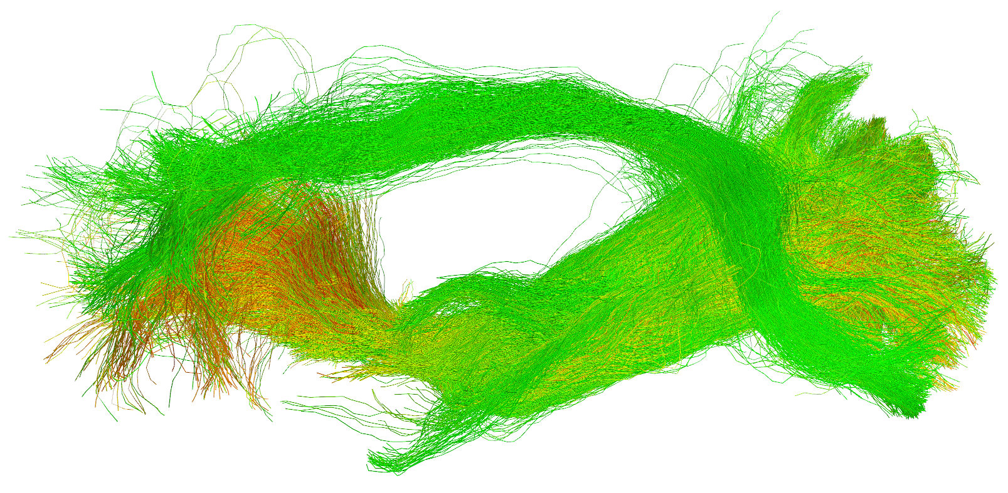
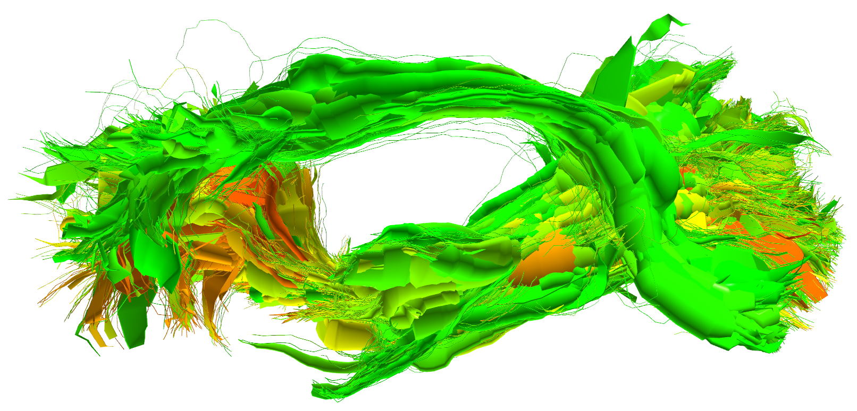
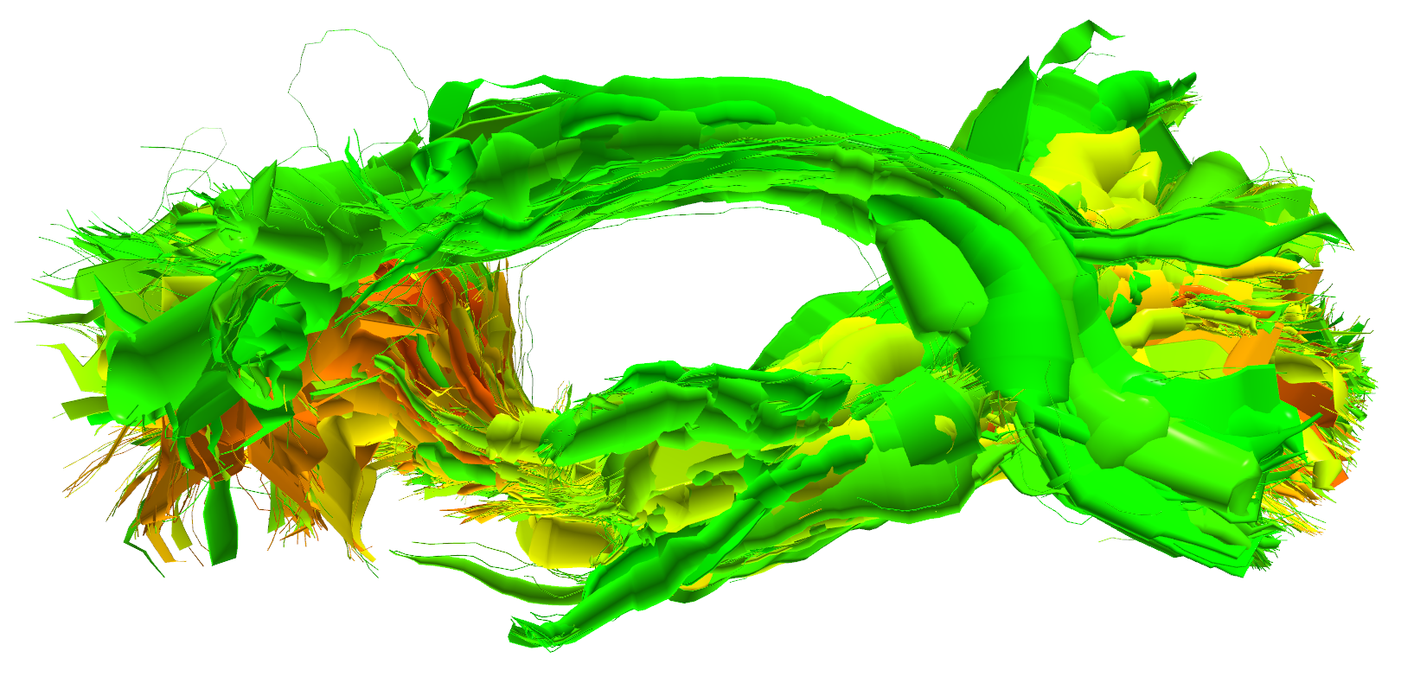
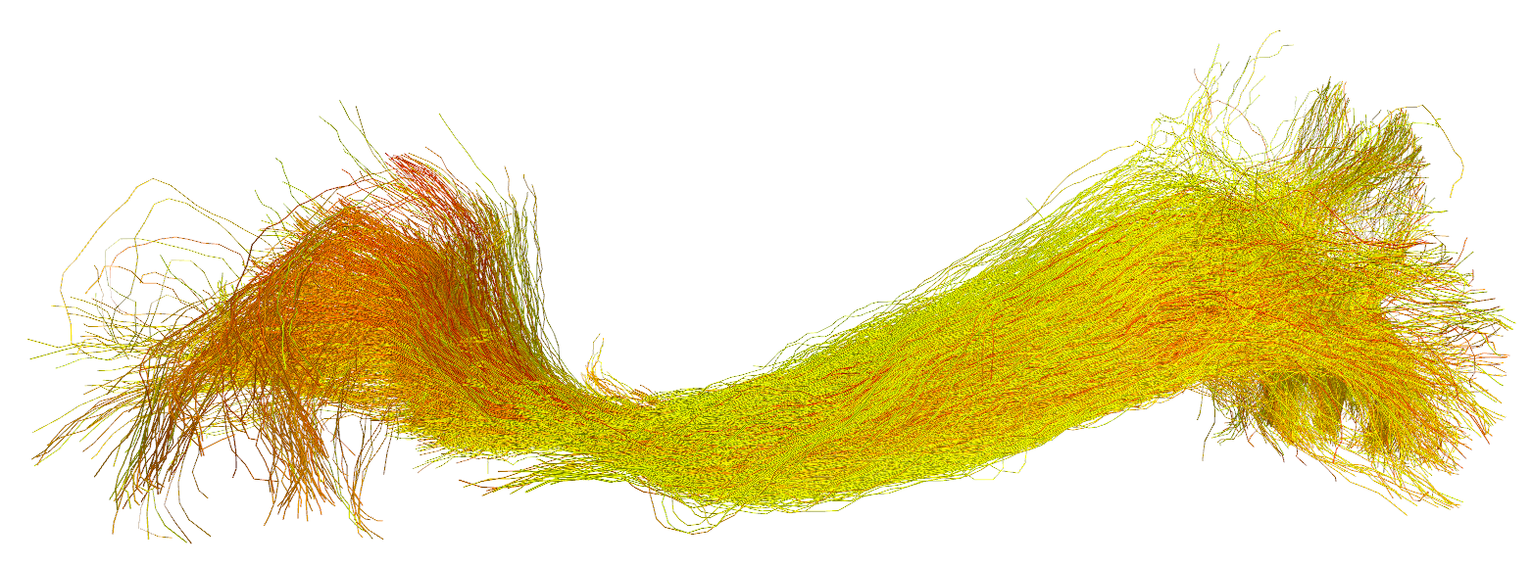
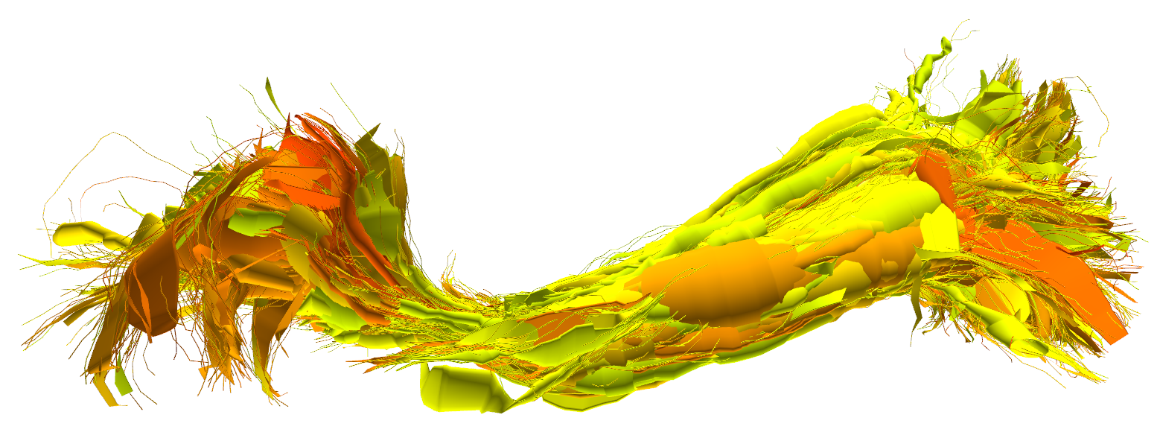
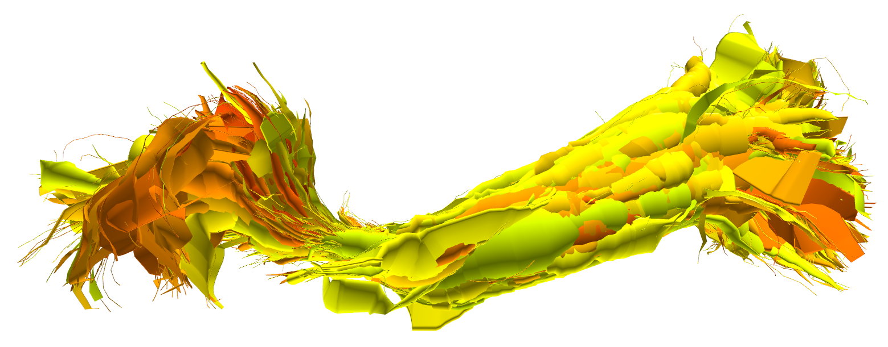
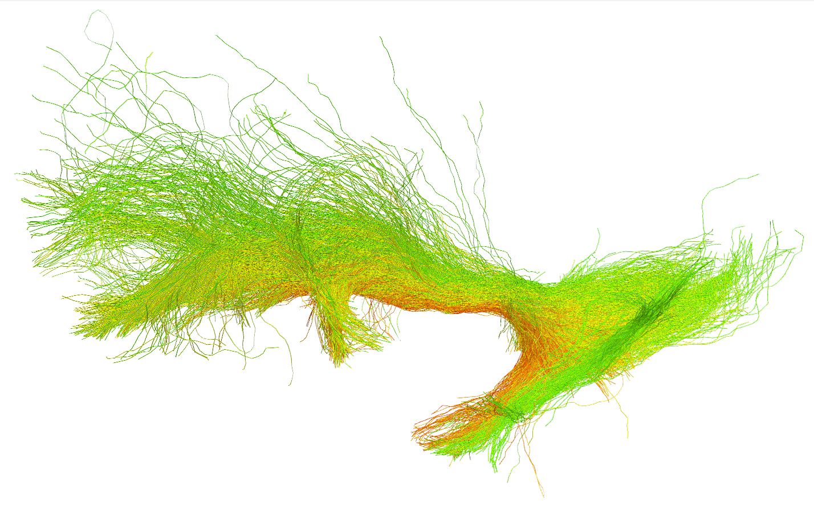
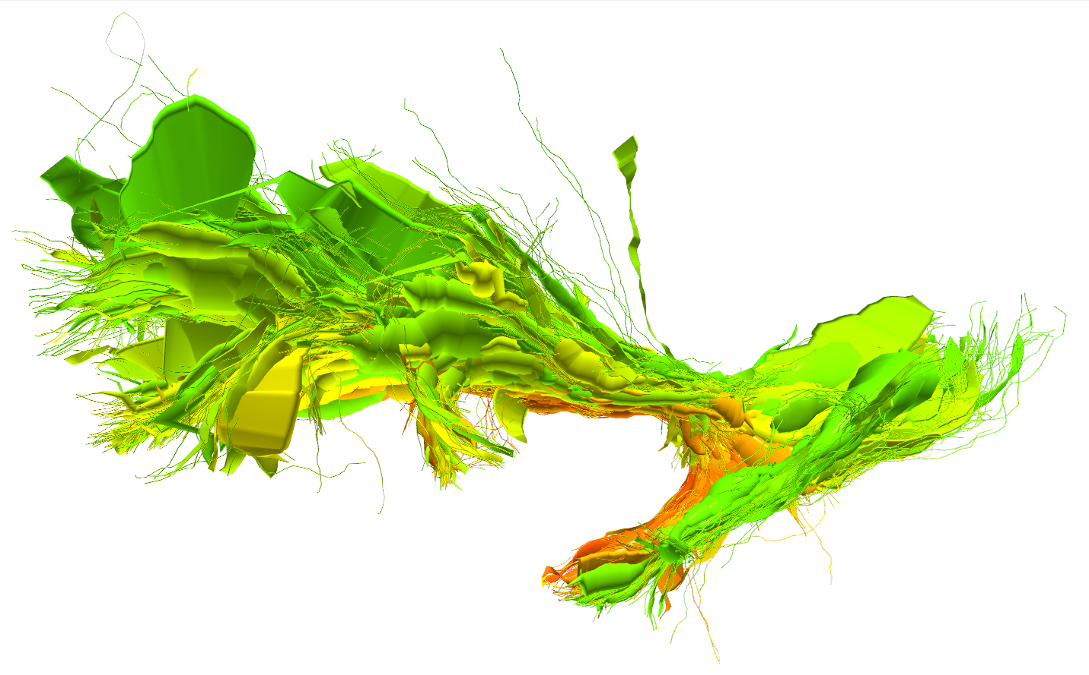
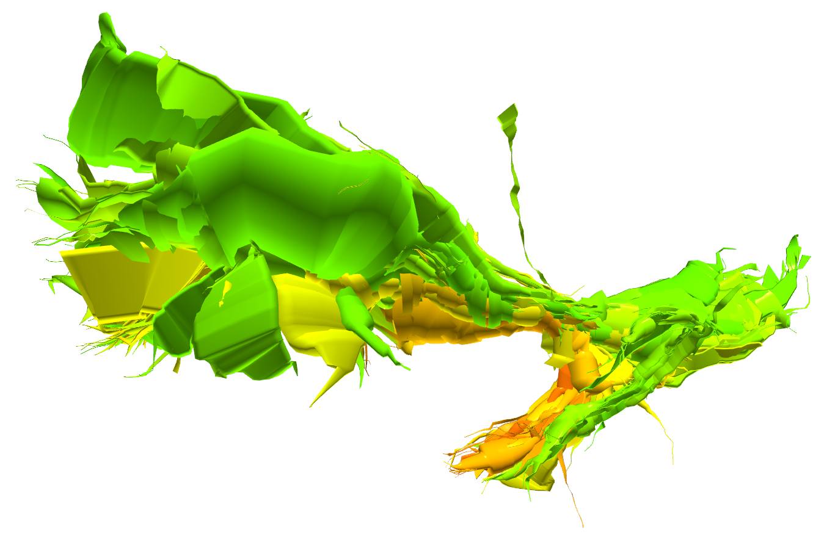
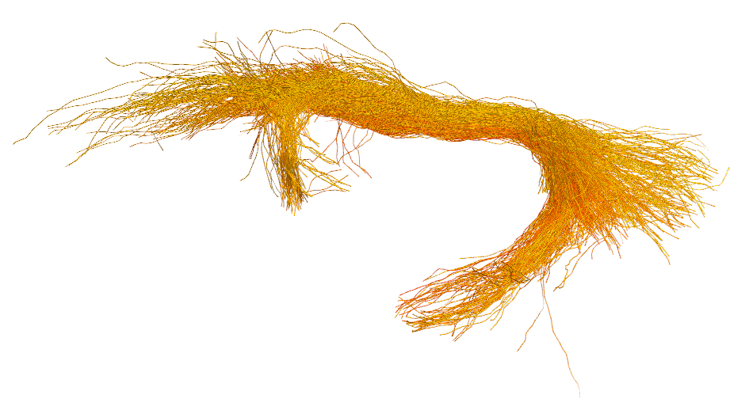
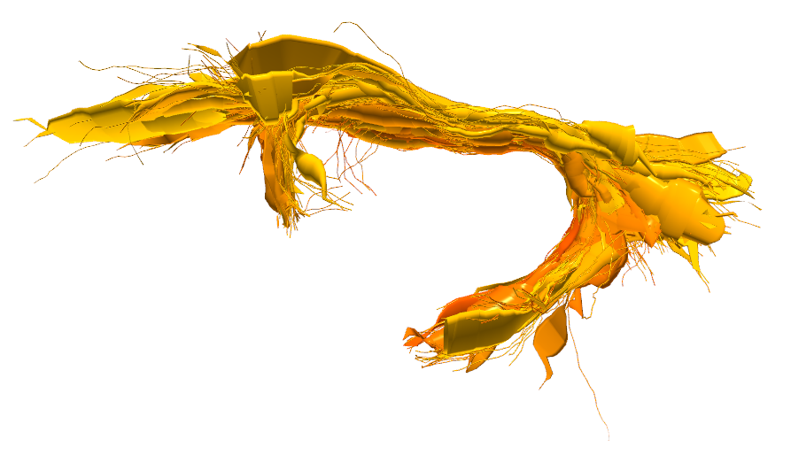
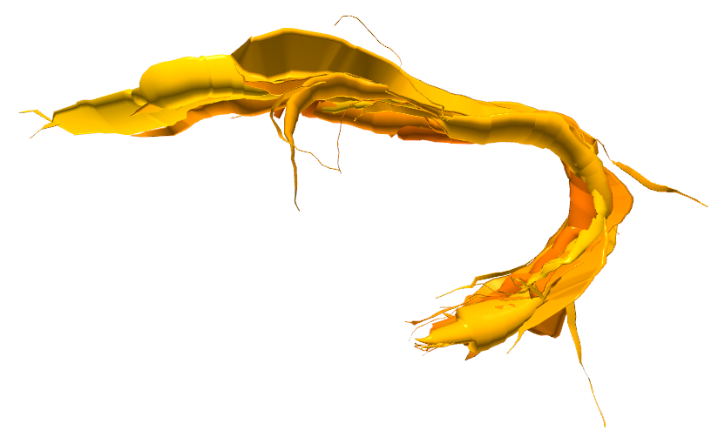





White Matter Multi-Resolution Segmentation Using Fuzzy Set Theory
*Alessandro Delmonte^{1,2}, *Corentin Mercier^{1,3}, Johan Pallud⁴, Isabelle Bloch^{1,2}, Pietro Gori¹
¹LTCI, Télécom ParisTech, Paris-Saclay University, Paris, France
²IMAG2 Laboratory, Imagine Institute, Paris, France
³LIX, Ecole Polytechnique, Palaiseau, France
⁴Neurosurgery Department, Sainte-Anne Hospital, Paris, France
* contributed equally to this work
INTRODUCTION / OBJECTIVE
Qualitative anatomical definitions of white matter tracts are mostly based on spatial relations with respect to anatomical structures. Translating these definitions into operational algorithms calls for mathematical models representing the intrinsic vagueness of theQualitative anatomical definitions of white matter tracts are mostly based on spatial relations with respect to anatomical structures
SPATIAL RELATIONS MODELING
Qualitative anatomical definitions of white matter tracts are mostly based on spatial relations with respect to anatomical structures. Translating these definitions into operational algorithms calls for mathematical models representing the intrinsic vagueness of the definitions.
Qualitative anatomical definitions of white matter tracts are mostly based on spatial relations with respect to anatomical structures. Translating these definitions into operational algorithms calls for mathematical models representing the intrinsic vagueness of the definitions.
ACS 1
ACS 2
ACS 3
IFOF
UF
0
ACS
1
MULTI-RESOLUTION REPRESENTATION
FIBERS
Original Bundle
CYLINDERS
Medium Resolution
CYLINDERS
Low Resolution
0.8
09/04/2019
ACS 1
IFOF
ACS 2
0
ACS 1
1
UF
ACS 2
0
IEEE International Symposium on Biomedical Imaging – 2019 – Venice (IT)
RESULTS AND PERSPECTIVES
Qualitative anatomical definitions of white matter
Translating these definitions into operational
Translating these definitions into operational
References
[1] I. Bloch, “Fuzzy spatial relationships for image processing and interpretation: a review”, Image and Vision Computing, vol. 23, no. 2, pp. 89–110, 2005.
[2] A. Delmonte et al., “Segmentation of White Matter Tractograms Using Fuzzy Spatial Relations”, in Organization for Human Brain Mapping (OHBM), Singapore, 2018.
[3] C. Mercier et al., “Progressive and Efficient Multi-Resolution Representations for Brain Tractograms”, in EG VCBM, 2018.
[4] P. Gori et al., “Parsimonious Approximation of Streamline Trajectories in White Matter Fiber Bundles,” IEEE TMI, vol. 35, no. 12, pp. 2609–2619, 2016.
alessandro.delmonte@institutimagine.org
corentin.mercier@telecom-paristech.fr
Poster n°582
Contacts:

